Slide 1

Rapid Mapping
Volcanic Eruption in La Palma
Pablo García García

Slide 2
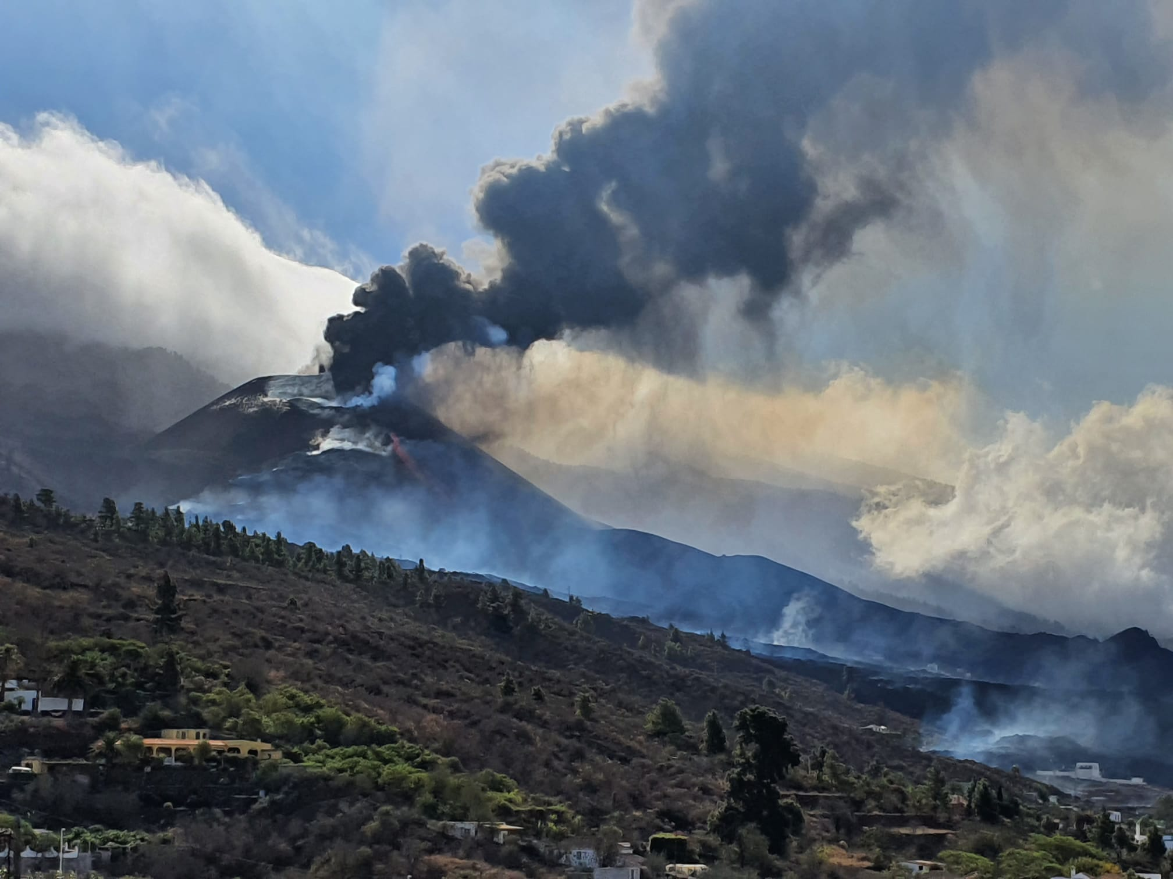
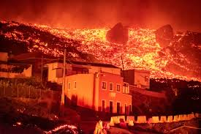
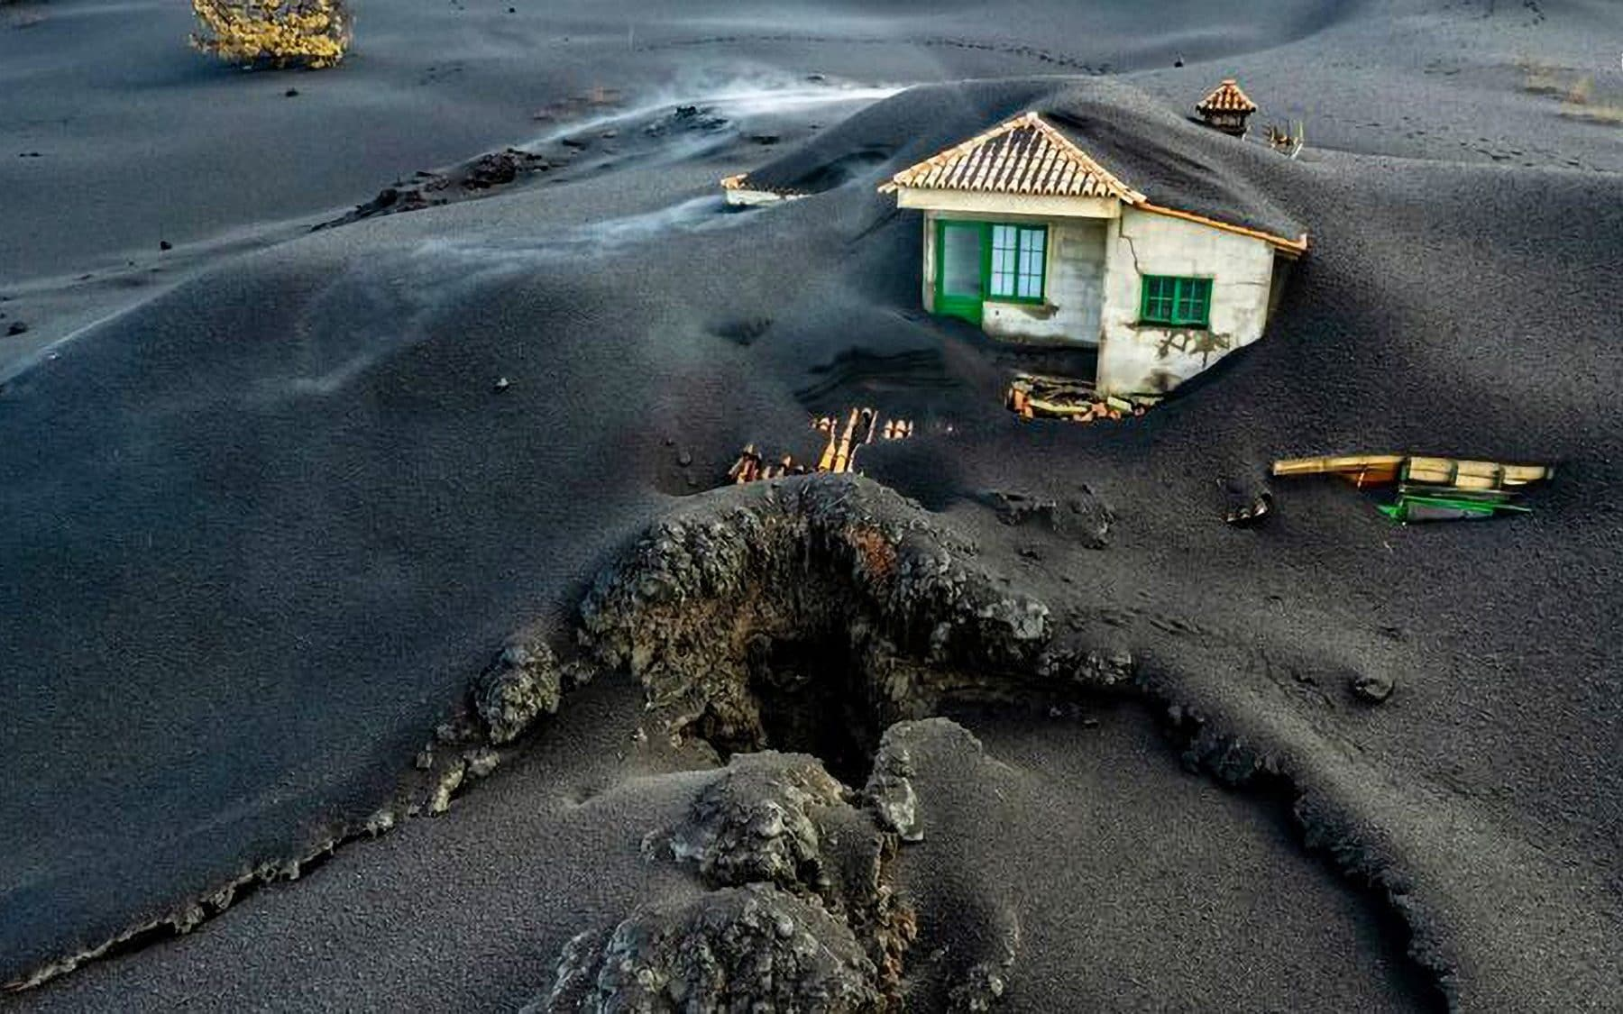
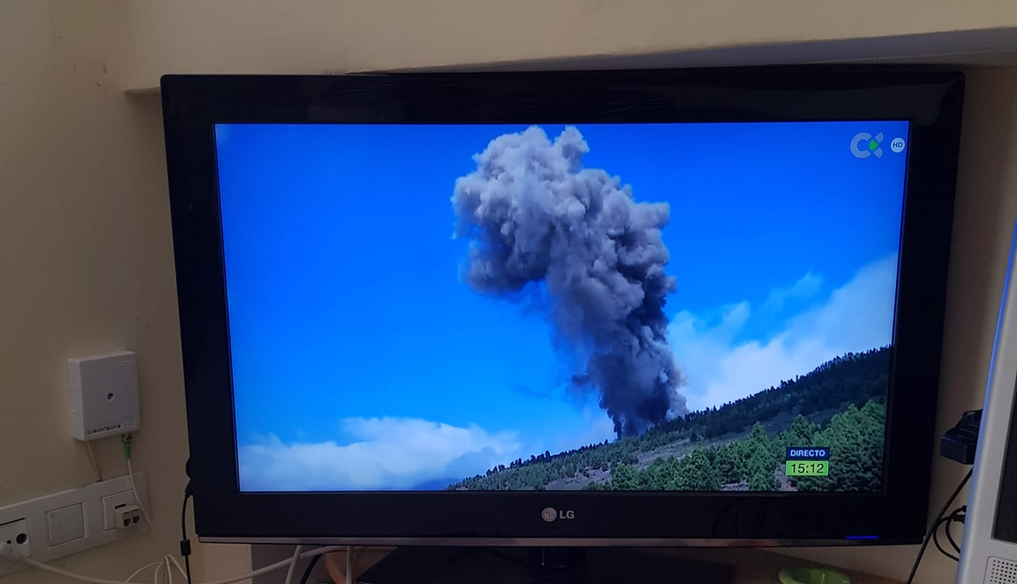
October, 2021
Notes:
This picture was taken by my parents on the island of La Palma, Canary Islands, in September 2021.
There was a volcanic eruption that lasted for almost 3 months.

Slide 3
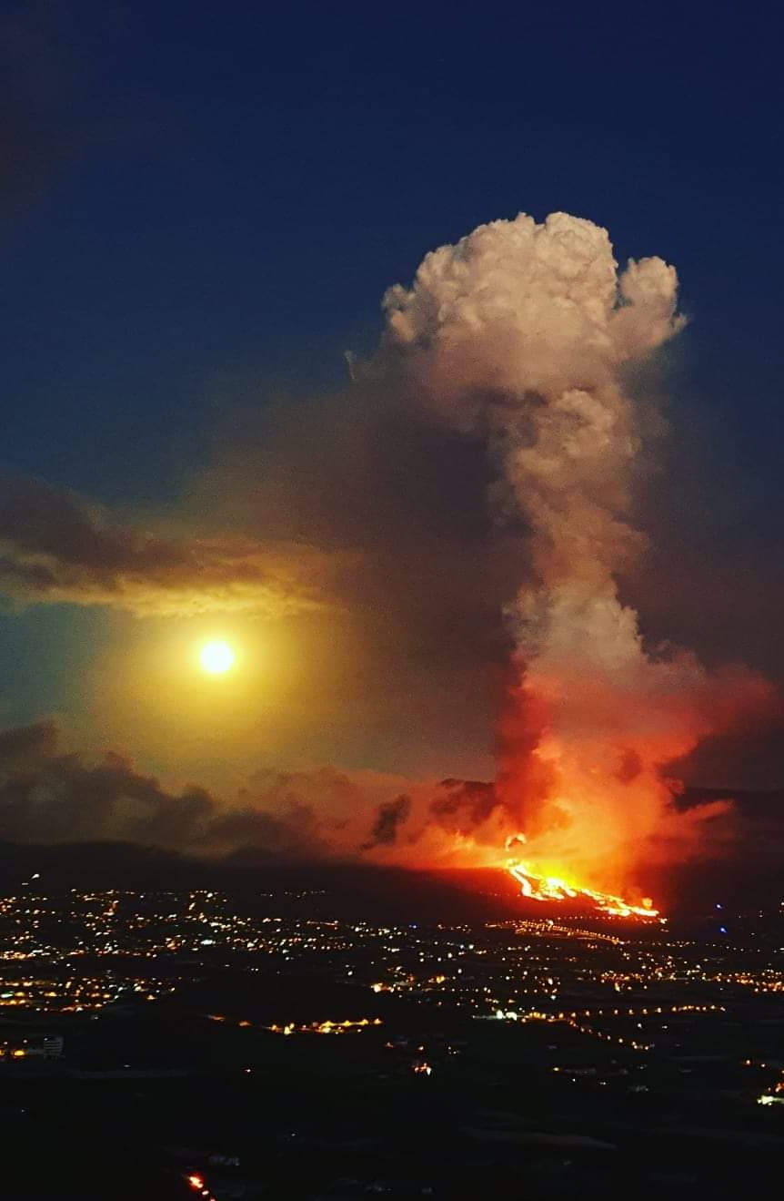
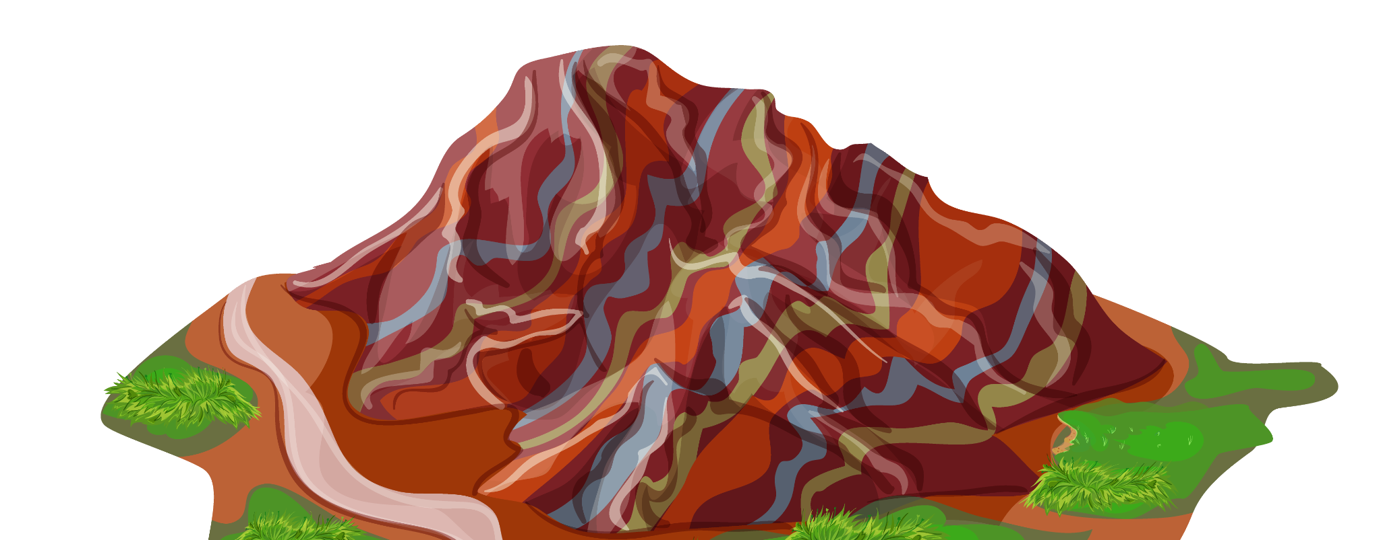
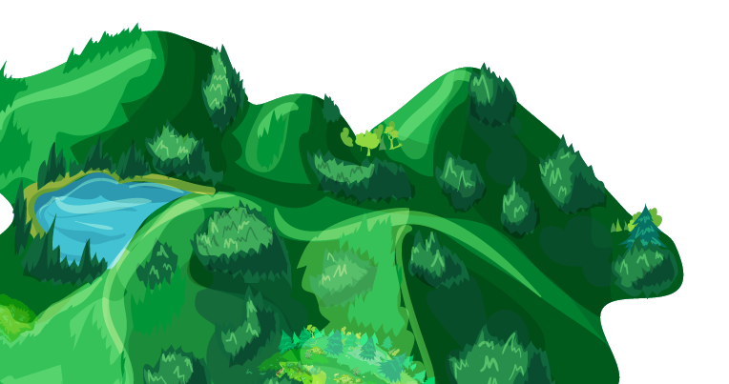


> 7000
> 3000
12 km²
843 Million €
Evacuated people
Destroyed buildings
Affected area
Total material damage
Notes:
Luckily, there were no casualties but it had a big impact on the island.
This picture shows that this part of the island is actually quite populated.
More than 7000 people evacuated, 3000 destroyed buildings, etc.

Slide 4






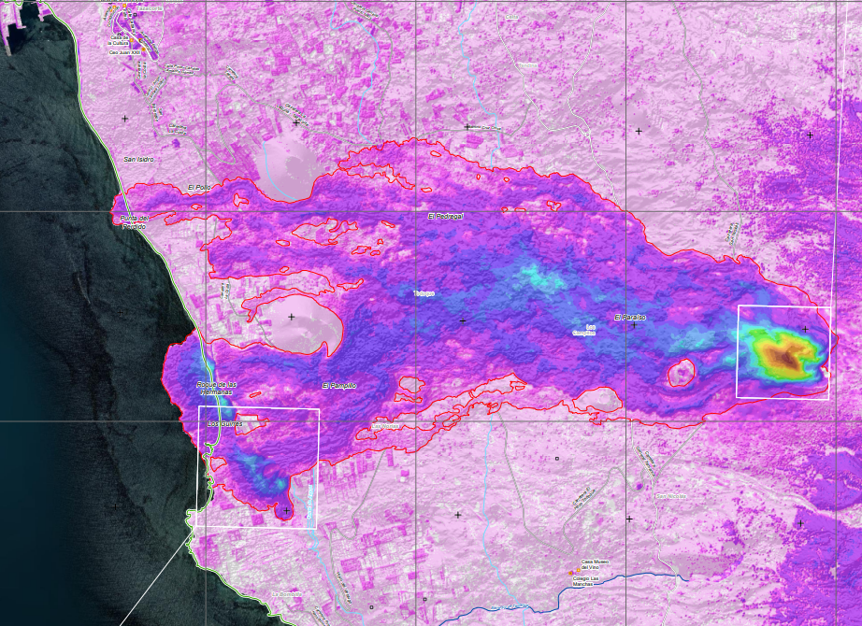
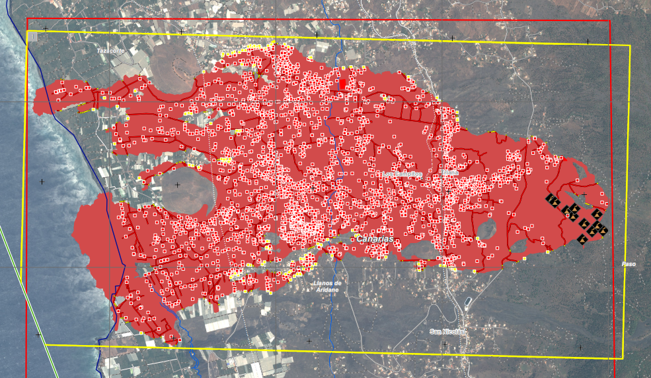
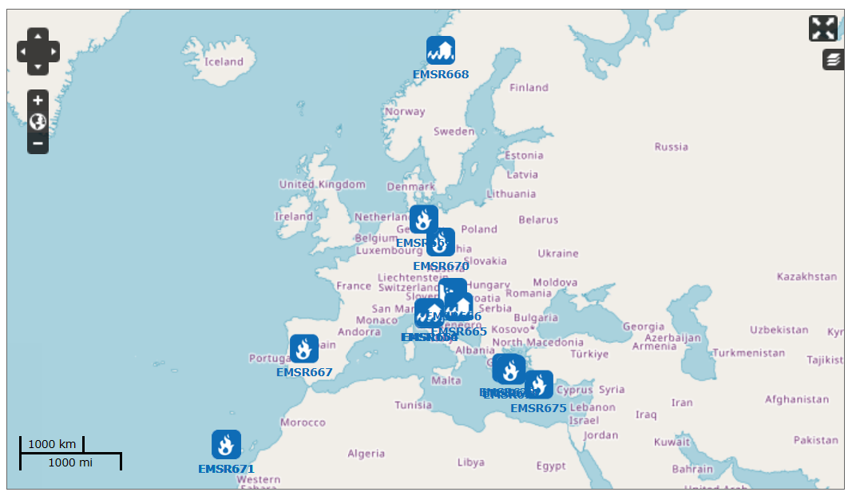



Rapid Mapping
Landslide
Flood
Storm
Fire
Eruption
Earthquake
Technical Accident
Notes:
During the eruption I came across this service from the European Union called Rapid Emergency Mapping (REM):
Provides cool maps within hours or days of catastrophic events or humanitarian crises
Free of charge
Accessible through a web portal
Clicking on the region you can access very cool maps - these are just an example of the maps created for the volcanic eruption in La Palma.

Slide 5

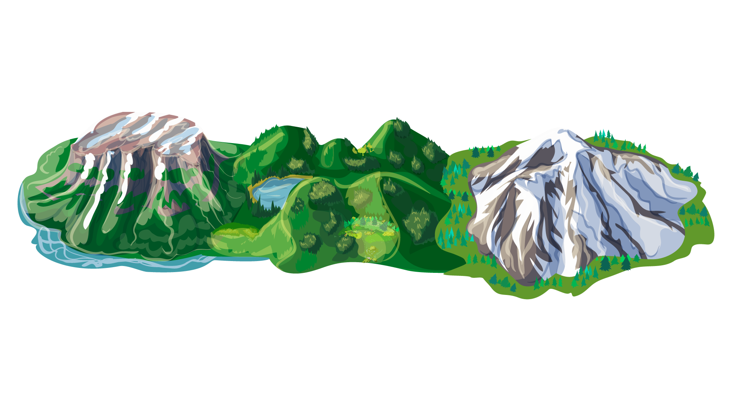
Objectives
Write Python code to automate…
Area covered by the lava flow
Number of buildings affected by the eruption
Island’s morphology change
Notes:
My objectives for this project were:
Write some code to reproduce the maps created by the Copernicus Rapid Emergency Mapping program using Python.
Specifically:
Determine the area affected by the lava flow
Determine the number of buildings affected by the eruption
Determine the island’s morphology change

Slide 6




Data
Satellite images
Digital terrain models
Point Cloud Data
Notes:
Data for this project was taken from:
EU’s Copernicus program: satellite images from the EU Copernicus program.
Spanish Mapping Agency: Digital terrain models from the Spanish Mapping Agency

Slide 7
Workflow
Extract Lava Flow
Classify
Buildings
Elevation
Change
Unsupervised Machine Learning
Supervised Machine Learning
Raster Difference (Rasterio library)
Notes:
Extract Lava Flow: satellite image with UML (KMeans and DBSCAN)
Classify Buildings: used a dataset

Slide 8
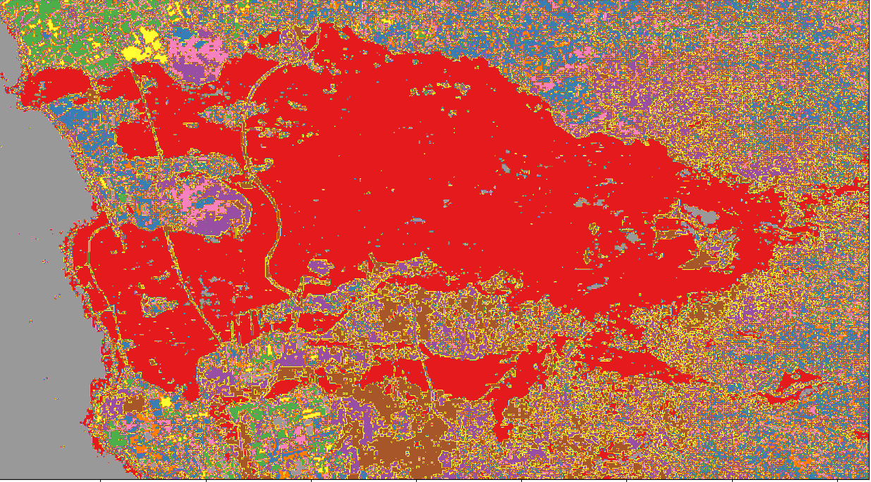
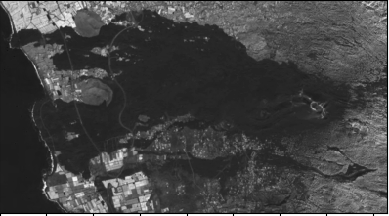
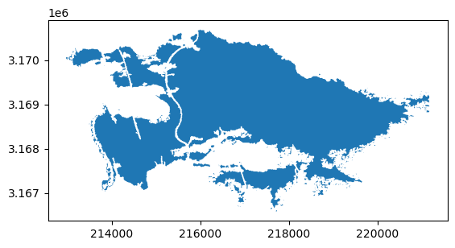
Lava Flow

Slide 9
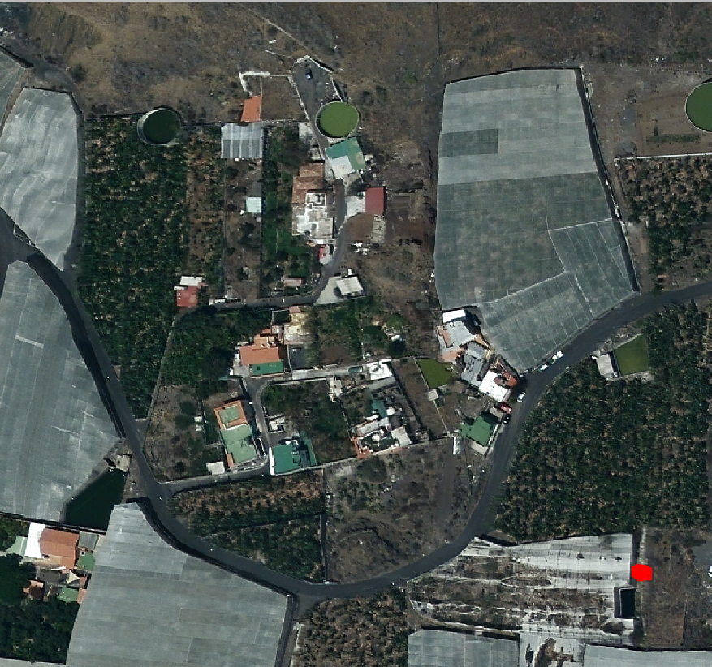
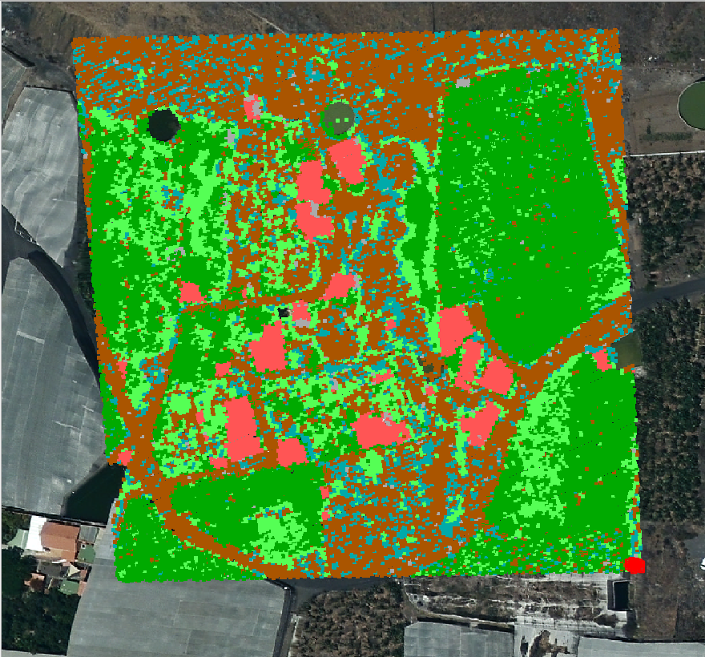
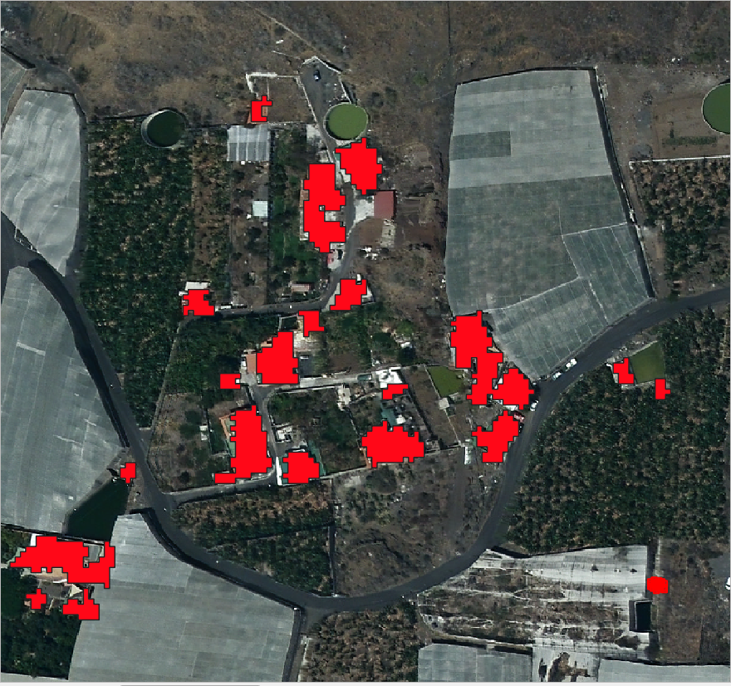
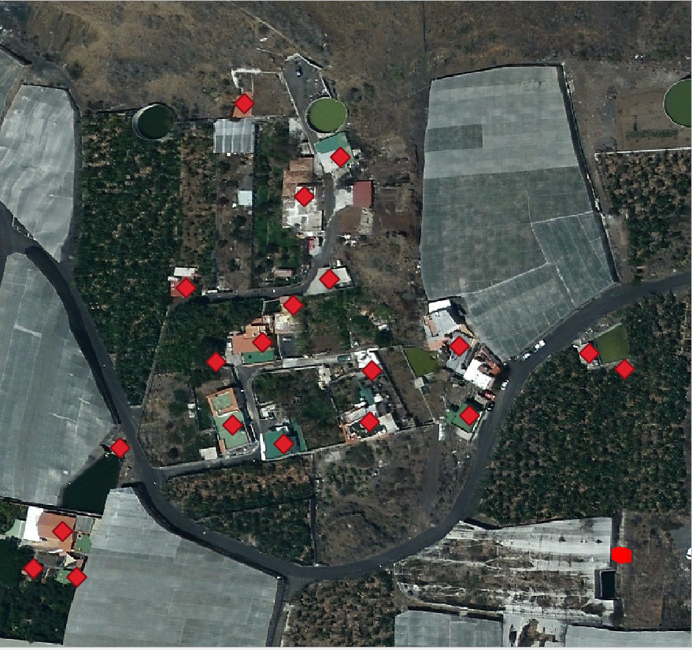
Buildings

Slide 10
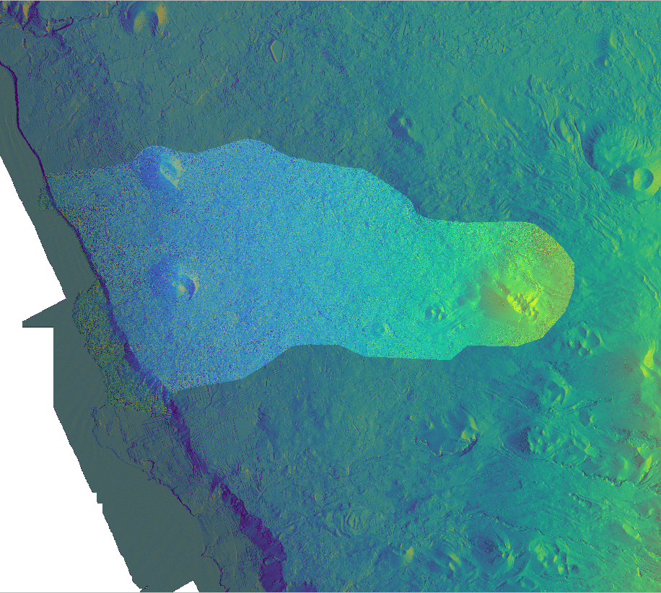
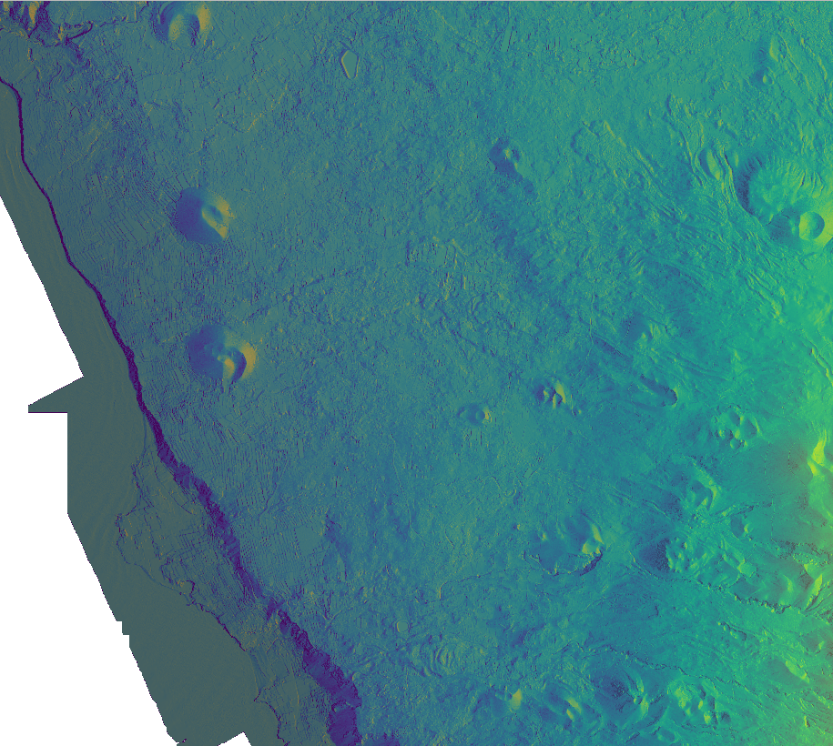
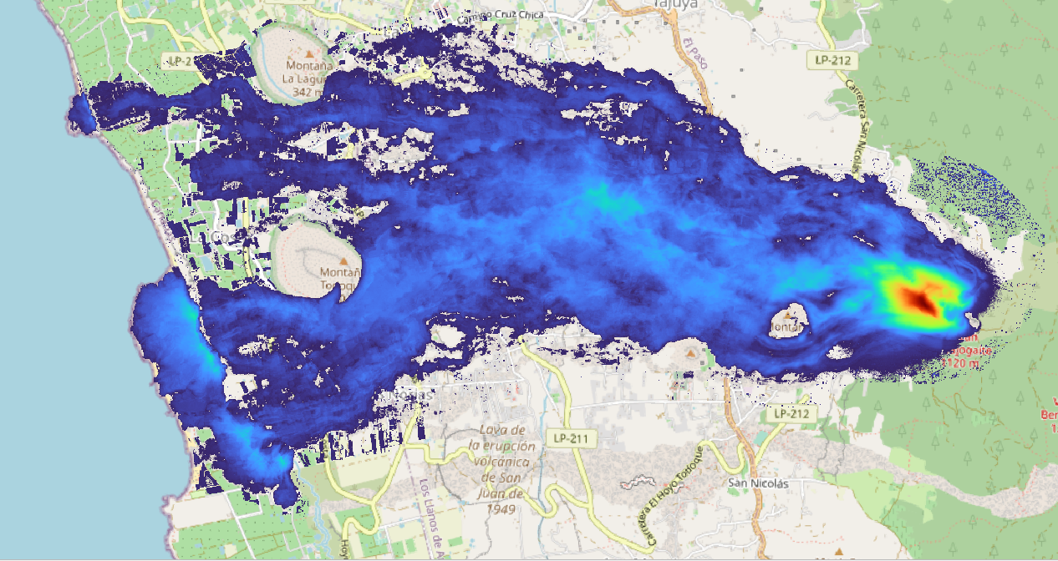
Elevation

Slide 11
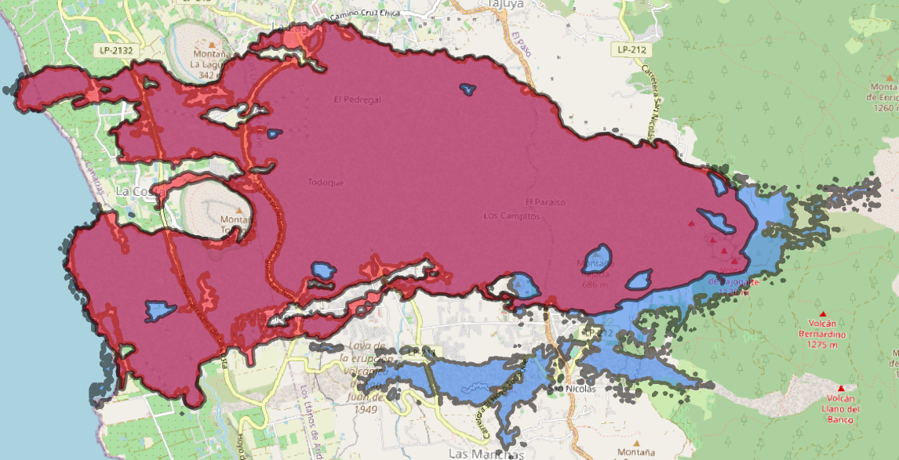
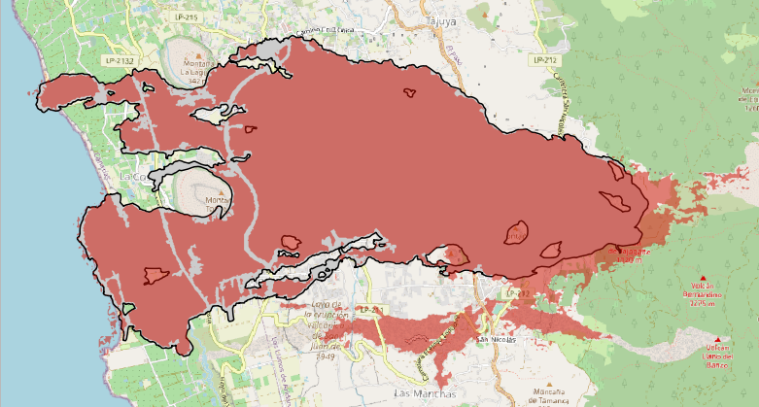
12.4 km² vs 12.9 km²
Results

Slide 12
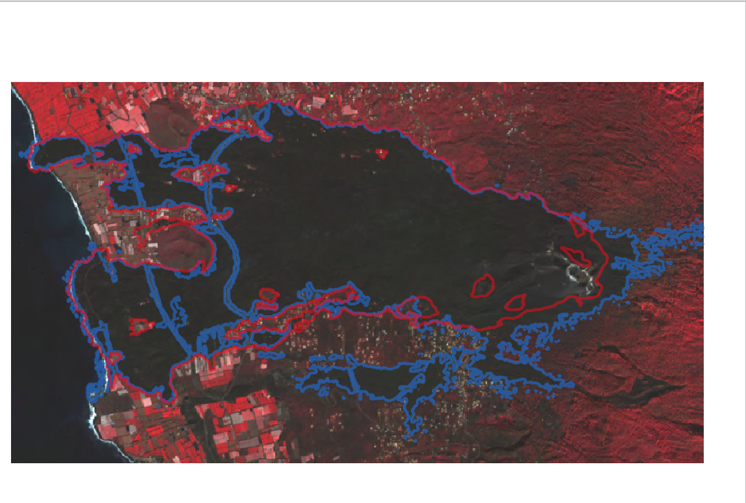
Difference: 0.5 km²
Results

Slide 13
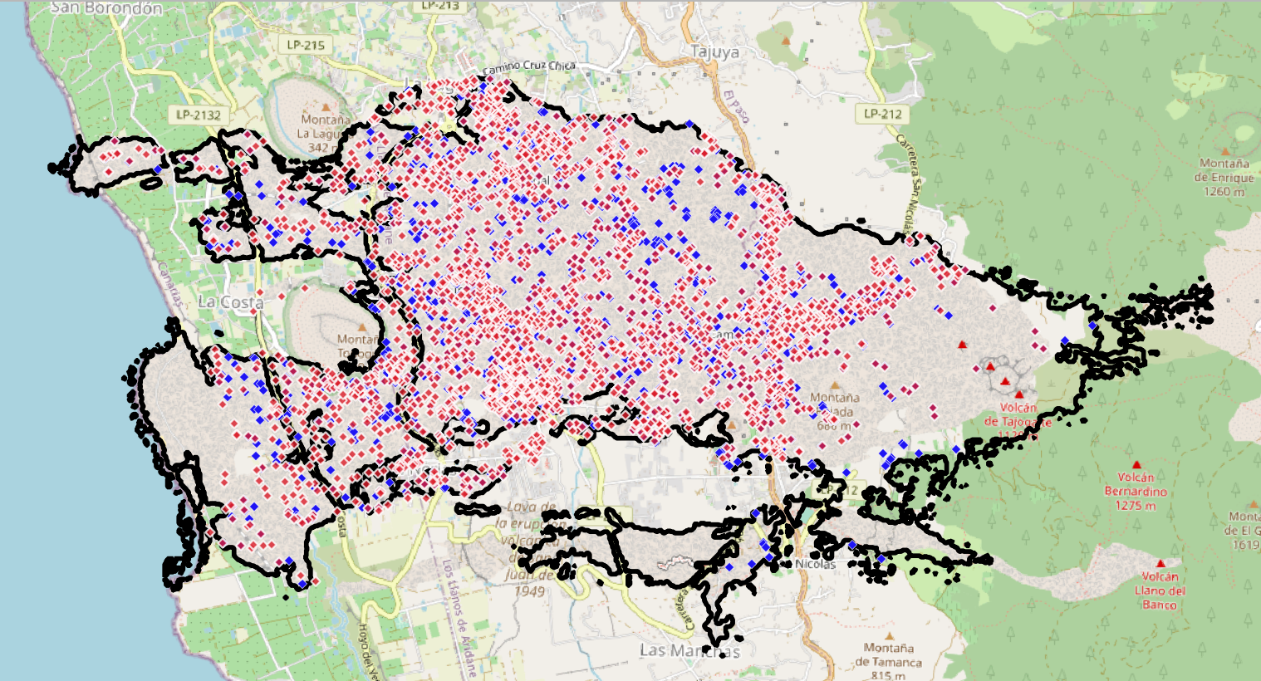
3126 vs 2567
Results

Slide 14
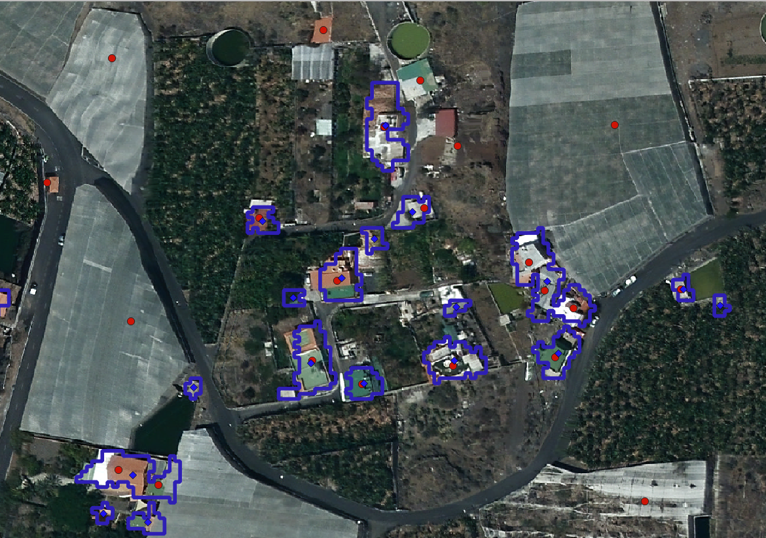
Difference: 559
Results
Notes:
Work in progress

Slide 15
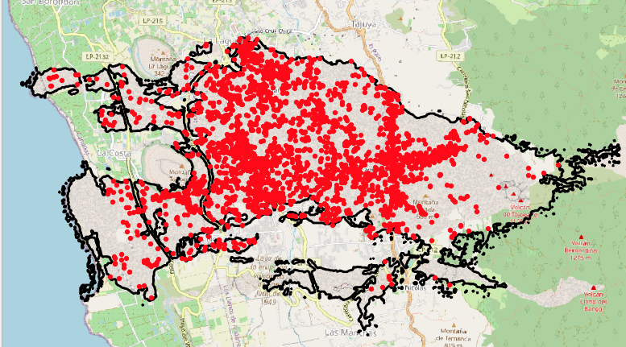
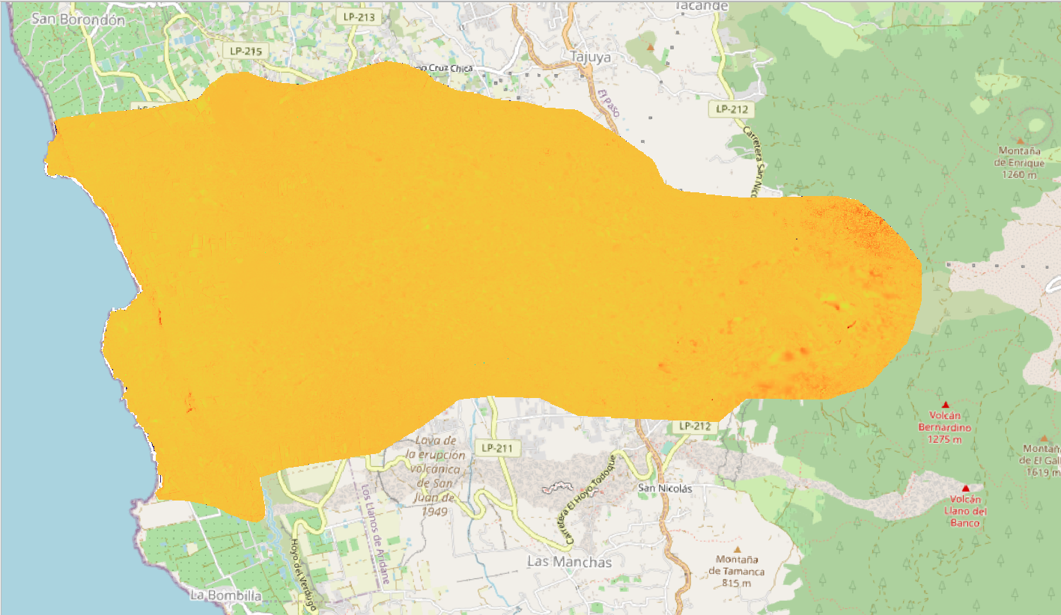
Results

Slide 16

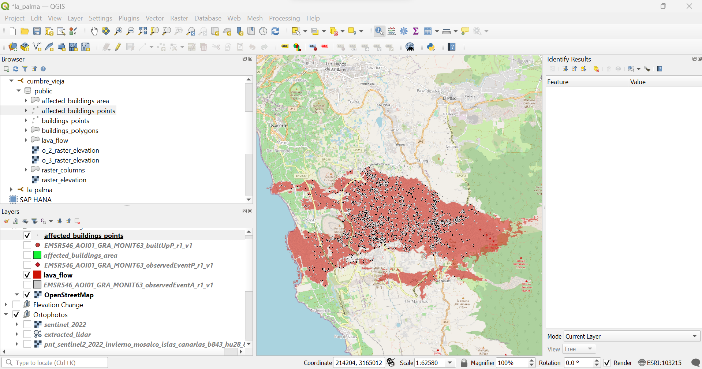

Database

Slide 17
Thanks!
Do you have any questions?

